Slide 1



Huggingface AND MagicBrush
Presented by:
Abdullah AlSalhi
Riyad Almalki

Slide 2

Concept
Huggingface
Models
Datasets
Spaces
MagicBrush Dataset

Slide 3
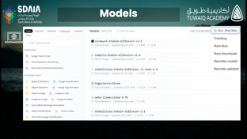
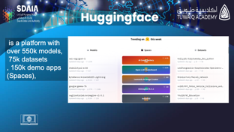
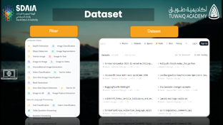

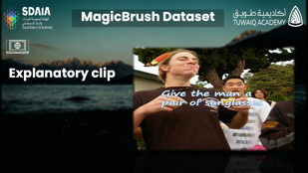
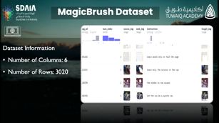


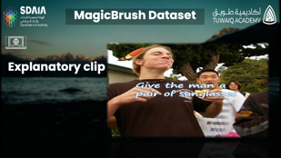


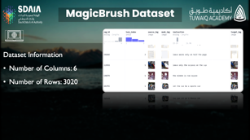
Huggingface.
PREV
NEXT

Slide 4
Huggingface.
PREV
NEXT

Slide 5
Huggingface.
PREV
NEXT

Slide 6


MagicBrush Dataset
PREV
NEXT

Slide 7


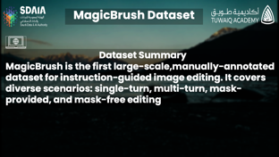
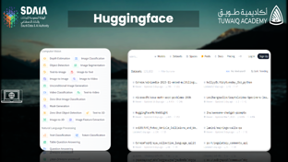
MagicBrush Dataset
PREV
NEXT

Slide 8
MagicBrush Dataset
PREV
NEXT

Slide 9

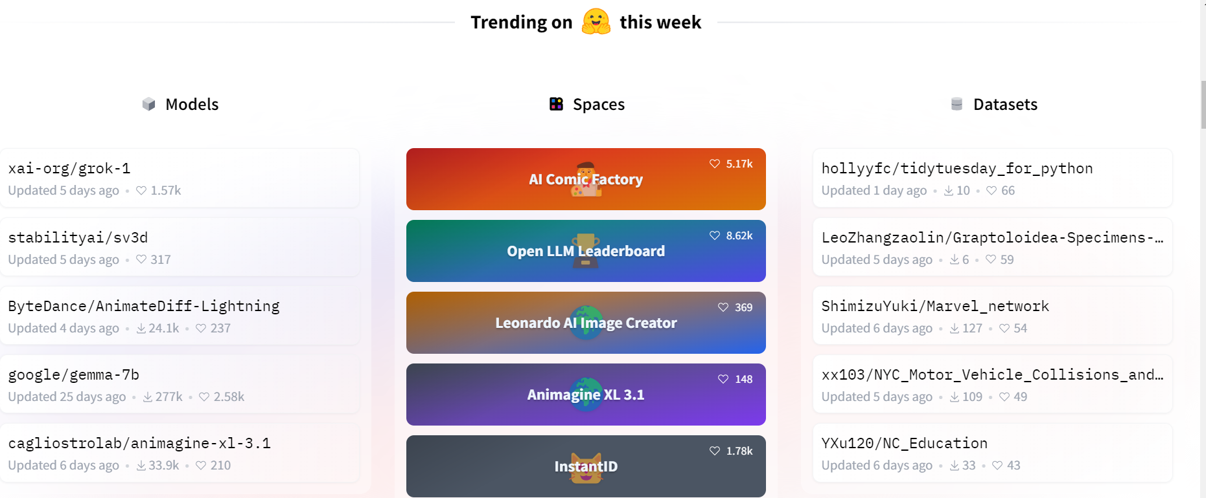

Huggingface
is a platform with
over 550k models,
75k datasets
, 150k demo apps (Spaces),

Slide 10

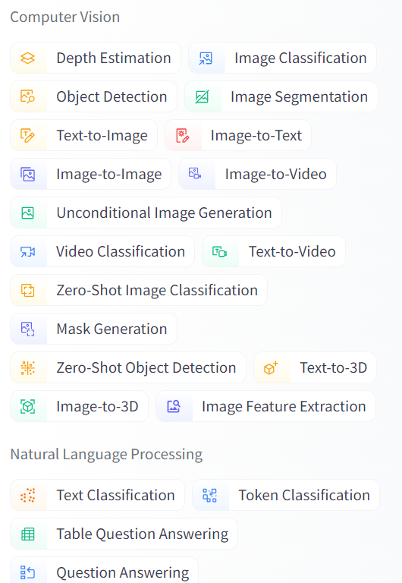
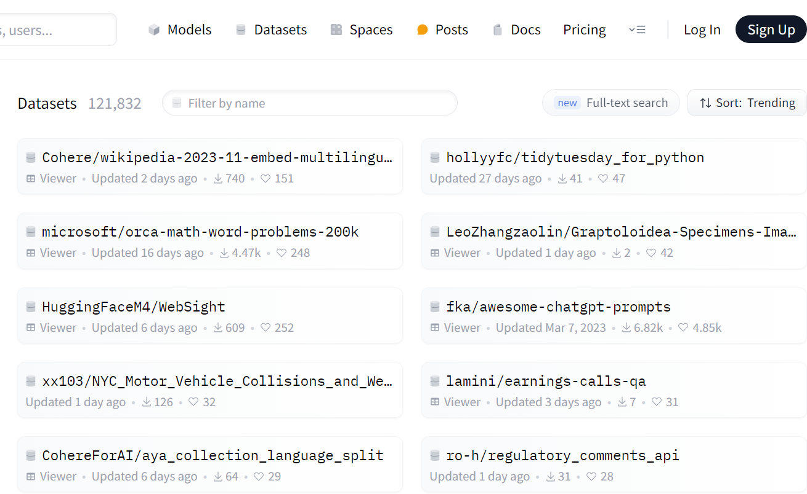
Dataset
Fliter
Dataset

Slide 11

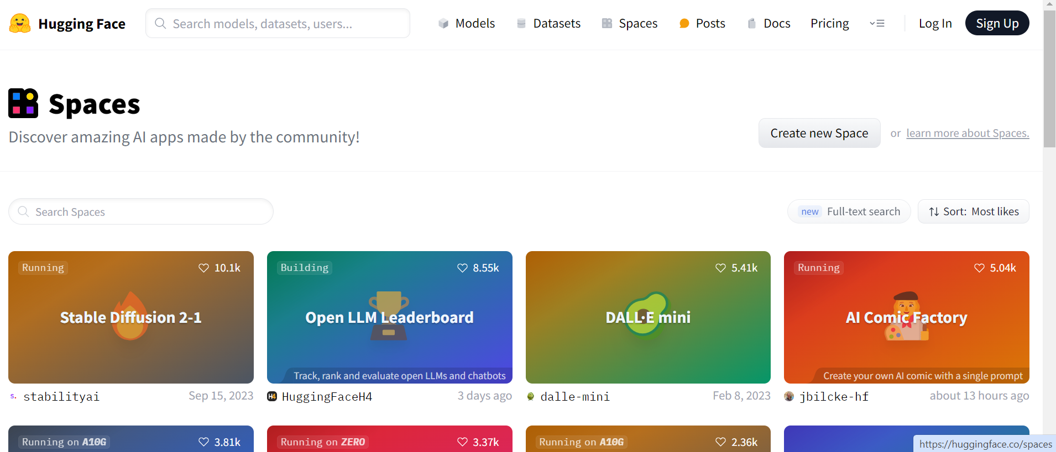
Spaces
Spaces: Discover amazing AI apps made by the community!

Slide 12
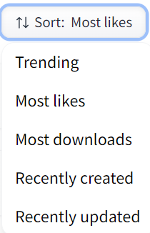
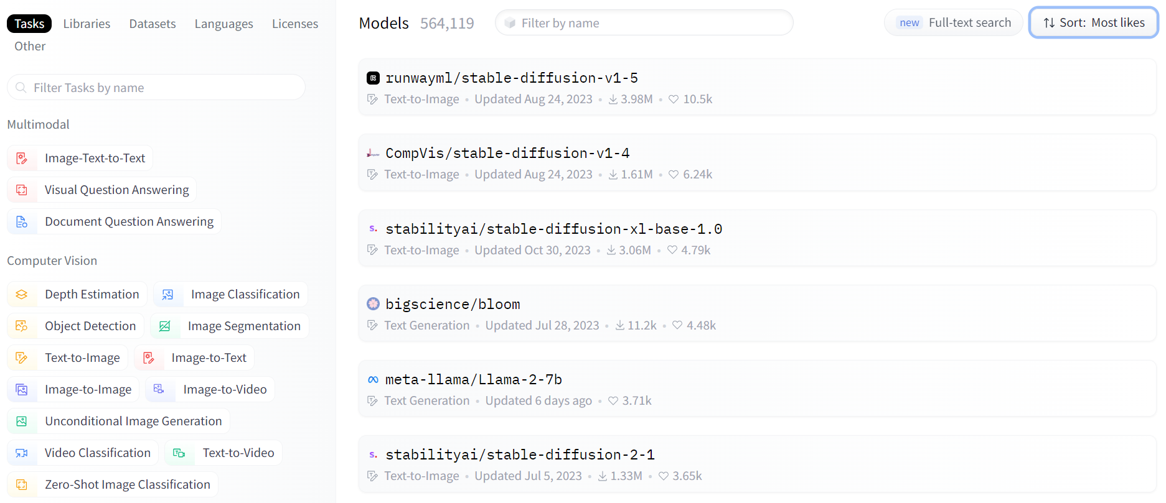
Models

Slide 13
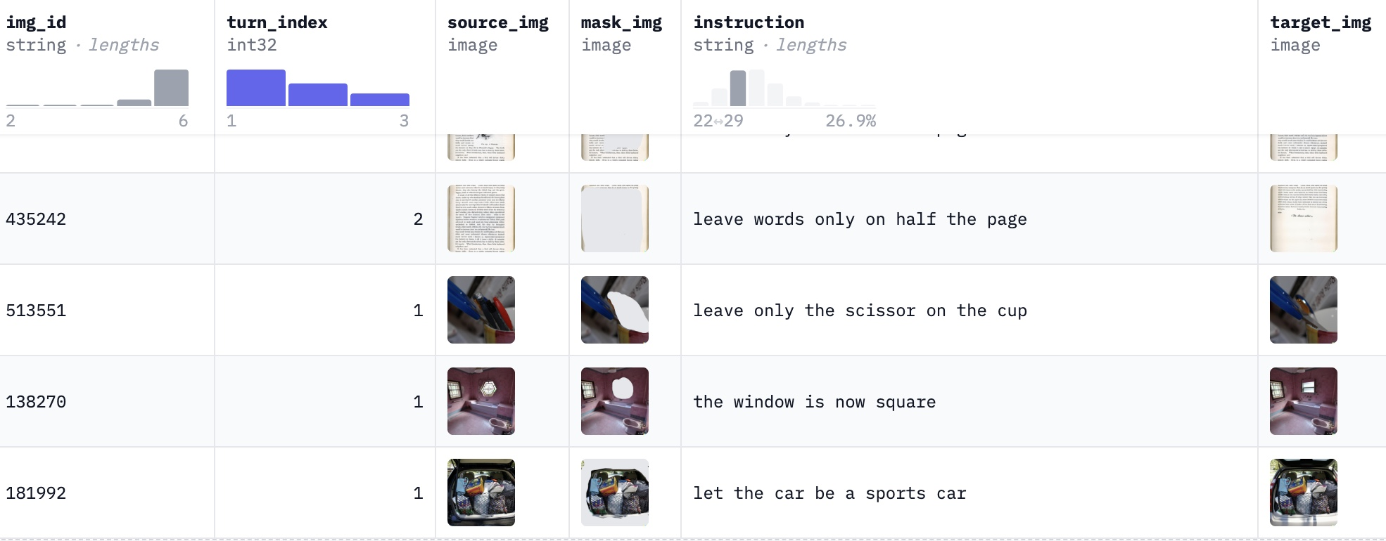
MagicBrush Dataset
Dataset Information
Number of Columns: 6
Number of Rows: 3020

Slide 14
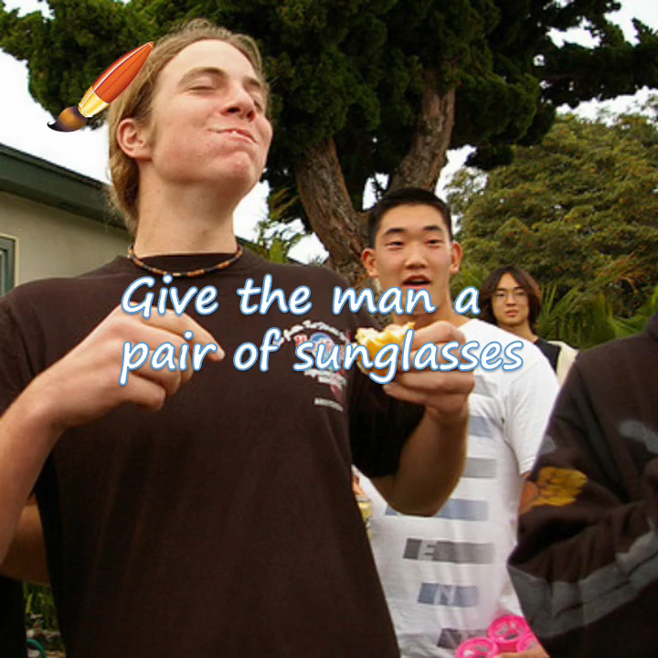
MagicBrush Dataset
Explanatory clip

Slide 15
Thank You!

